Slide 1


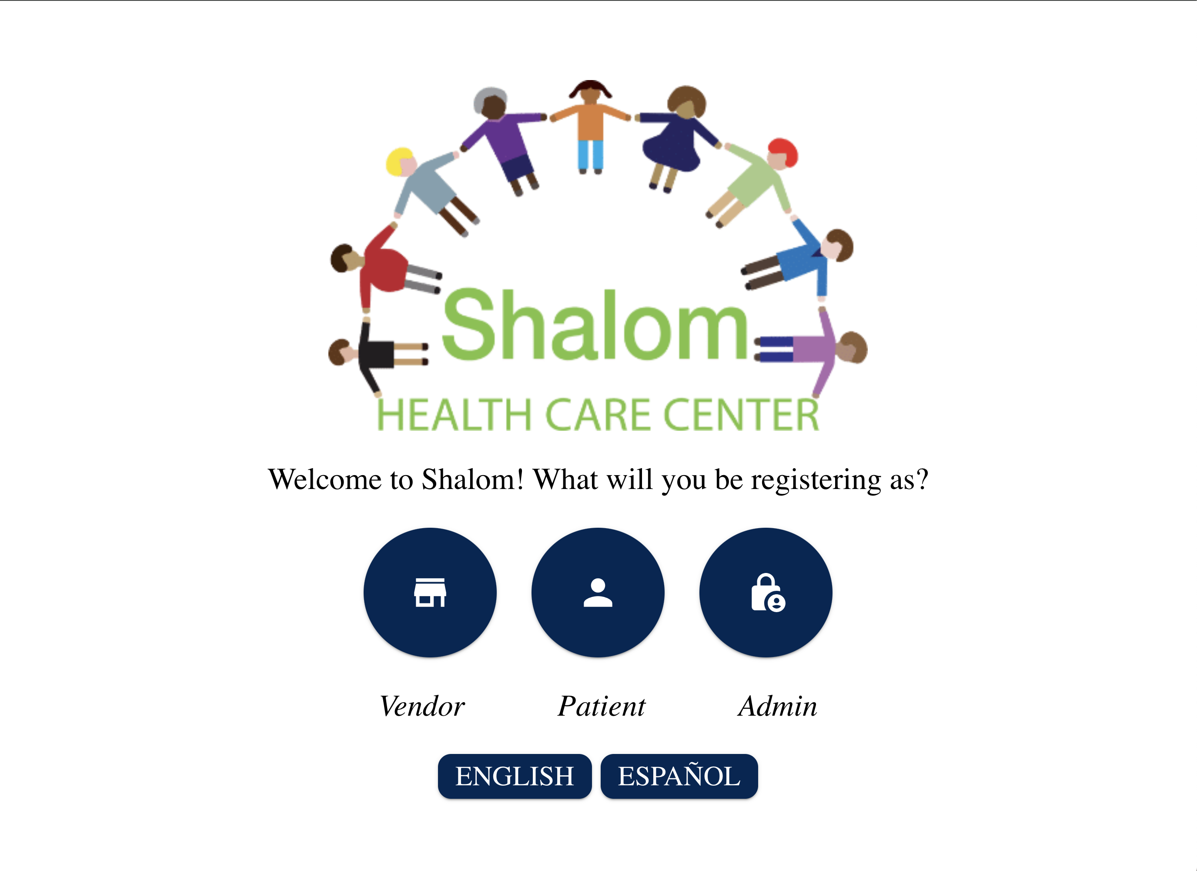
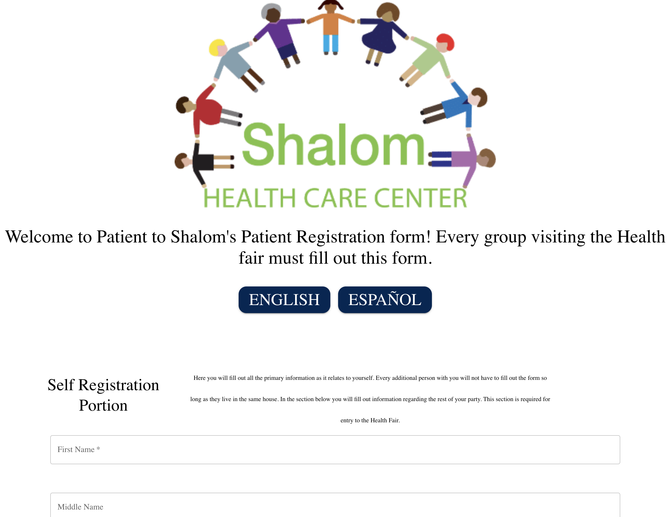
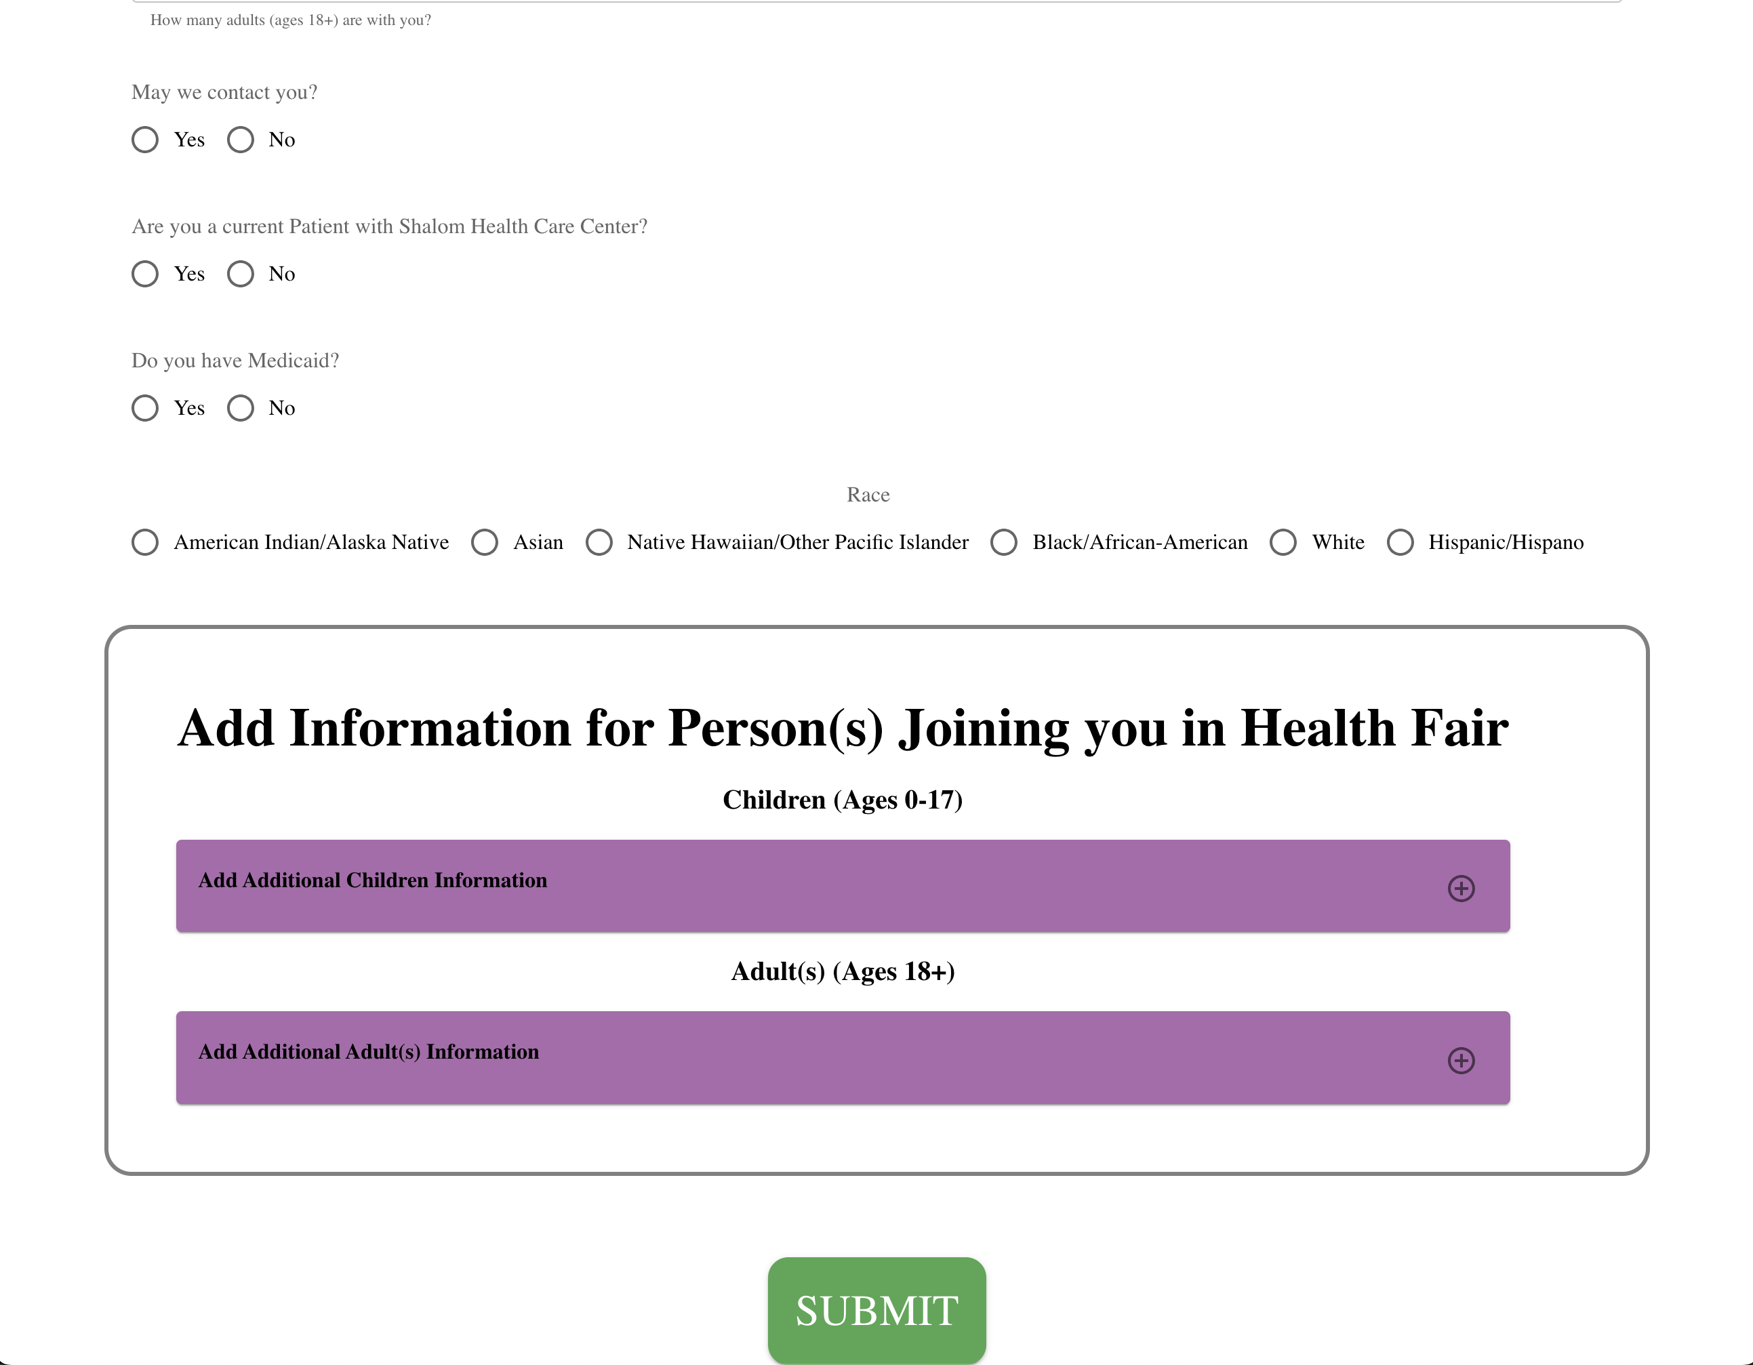
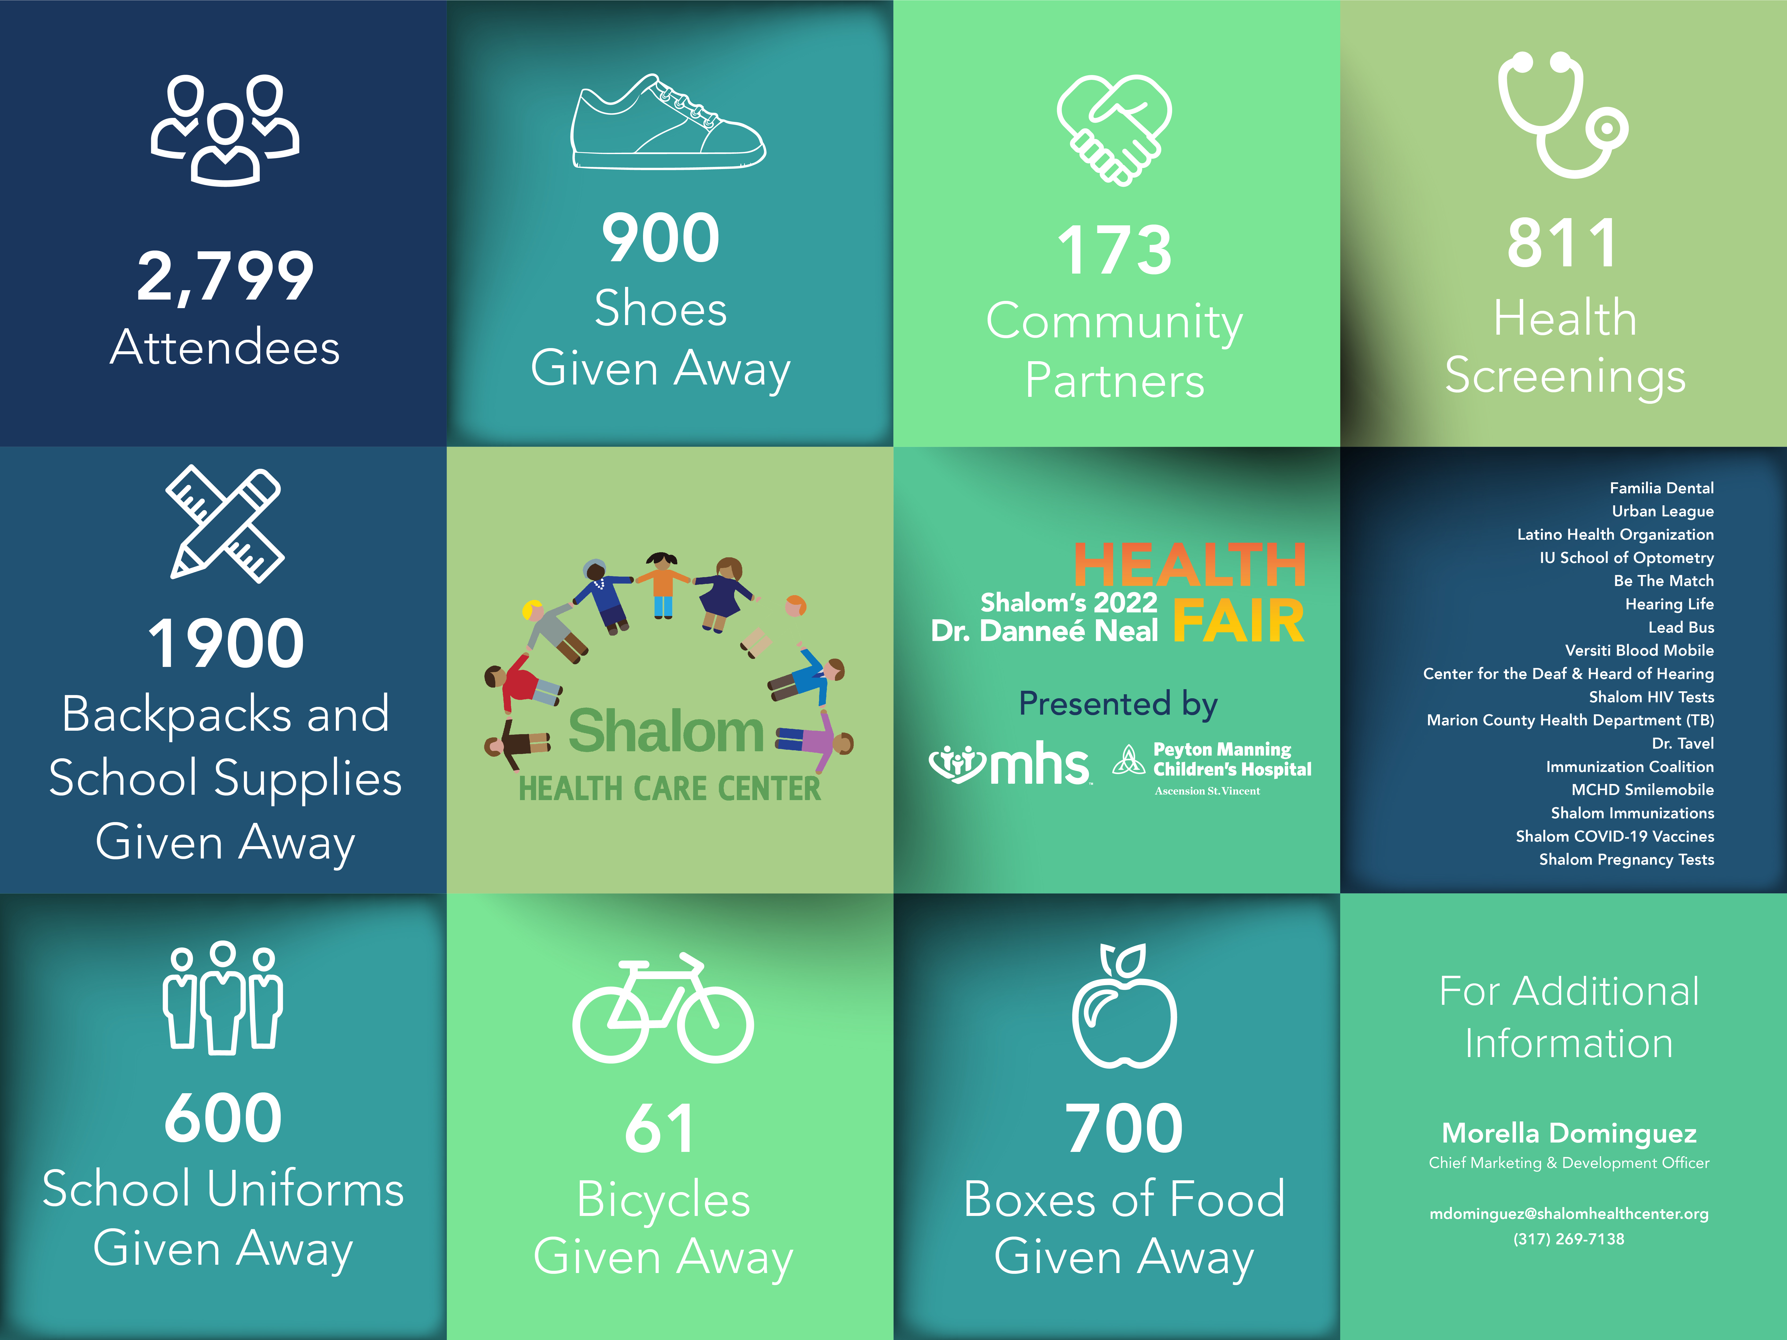
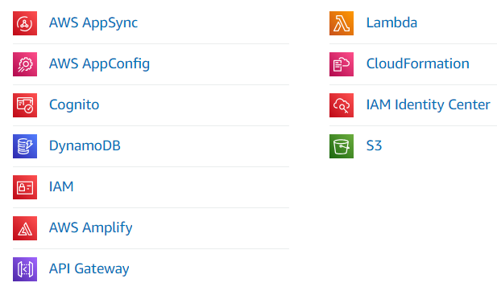
Shalom Health Care Registration Form: Digitization and Creation of Database
Reece Parks, Matt Fleschner, Rachel Maier, Hallie Nuccio, and Miles Mann
Butler College of Liberal Arts and Sciences – Computer Science Department
Team Introduction
Created reusable components that allow slight alterations so that web page visuals consistent throughout application
Designed and created a basic home navigation page to allow for further expansions of websites functionalities for future use
Implemented ability for one adult to register all related information to other family members in same group at health fair
Created a uniform and intuitive registration form for new/ returning patients to register for attendance in the Shalom Health Care Center Health Fair
Challenges
Reece Parks -- Team Leader: Manages the entire group, ensuring that each member is accomplishing assigned jobs. Creates and submits a Weekly Status Report and is the main point of contact for the professors.
Rachel Maier -- Front End Developer: Creates and analyzes the registration form. Includes using REACT to build the form based on a template received from client.
Matt Fleschner -- Back End Developer: Creates and analyzes the database. Includes using AWS to build tables and connections
Miles Mann -- Quality Assurance Tester: Tests and analyzes the results from the front-end and back-end. Figure out mistakes that may have been made and what changes could fix the errors.
Hallie Nuccio -- Client Liaison & Documentation: Communicates with the client on all aspects, setting up meetings and sending update emails. Keeps track of daily work so each progress can be checked.
Front-End Results (The Registration Form)
Finalization on the True Project Goals – Figuring out exactly what to accomplish along with Shalom's requirements.
Lack of Prior Resources – Deciding if it's of our best interest to completely restart or utilize last semester's progress.
Creation of Form Using REACT – Lack of REACT experience across the team.
Creation of Database – Forming an AWS database without much guidance.
Connection of Front-End and Back-End – Largest obstacle overall to be able to pull information from the form to the backend.
Conclusion/Reflection
Client Background and Information
In the end, there were two deliverables that we were able to provide to Shalom:
1) A local host that includes buttons for Patient, Admin, and Vendors.
Patient – directs the user to the form to be filled out upon arrival.
Admin – for use by Shalom.
Vendors – for use by vendors at the Health Fair.
2) A database in which the information from the forms will be held for querying and analyzation.
With these items created, Shalom will be able to do the following:
Improve the speed at which attendees can get through the registration process by digitizing.
Allow for easier analyzation through the use of queries.
Allow for easier documentation for future years.
Shalom Health Center -- medical home with two different locations in the greater Indianapolis area.
Mission: provide quality health care that is patient-centered, affordable, and accessible for all in the community while remaining compassionate, inclusive, and professional.
Currently serve over 13,350 patients and provide many different services such as Primary Care, Telemedicine, Behavioral Health, Health Promotion, HIV & PrEP Navigation, and School Based Clinics.
Shalom Annual Health Fair -- people from the community can come and receive care that they may not normally be able to access.
Partnership Goal: improve the efficiency of their Health Fair process, allowing individuals to visit more vendors than they have in the past.
Project Objectives
Back-End Results (The Database)
Digitize the Attendee Registration Form -- demographic information regarding the main individual from the household as well information about the accompanying adults and children.
Build a Database -- holds the information from each completed registration form. Will allow for easier analysis of event data to create graphics such as below.
Created AWS backend database utilizing tools such as DynamoDB, AWS AppSync, CloudFormation, and more.
Designed schema and formed tables for patients along with additional accompanying children and adults.
Implemented linkage between front and back end through AWS Amplify.
Used the following tools:
Future Work
Continue Implementing Language Functionality – ensure that switching from English to Spanish is efficient.
Get Test Data to Use – will provide insights to potential changes.
Addition of Vendors – allow vendor accessibility to database.
Acknowledgements
Dr. Panos Linos, Faculty Advisor, Butler CSSE
Dr. Muirul Haque, Faculty Advisor, Butler CSSE
Ms. Morella Dominguez, Client Contact & Advisor, Sholom Health Center
Mr. Fred Milch, Client Advisor, Shalom Health Center

